Slide 1
Breast Cancer Tumor Classification: A Glimpse at the Intersection of Machine Learning and Healthcare
Alec Hon
UCLAx Data Science Capstone Project
10/29/18
Notes:
Ipython: practice with seaborn and pandas

Slide 2
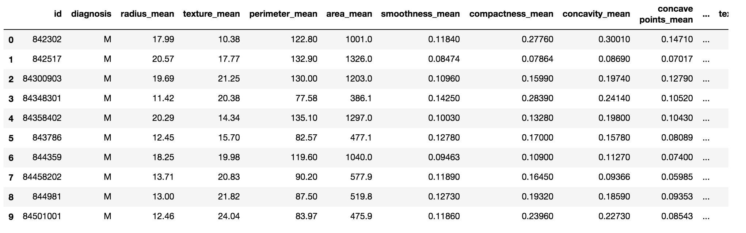
The Data
Data was obtained from the UCI Machine Learning Repository
1984 study from the University of Wisconsin by Dr. William Wolberg
569 Observations of 32 Variables
Notes:
ID, Diagnosis, and then 3 variables for 10 obs

Slide 3
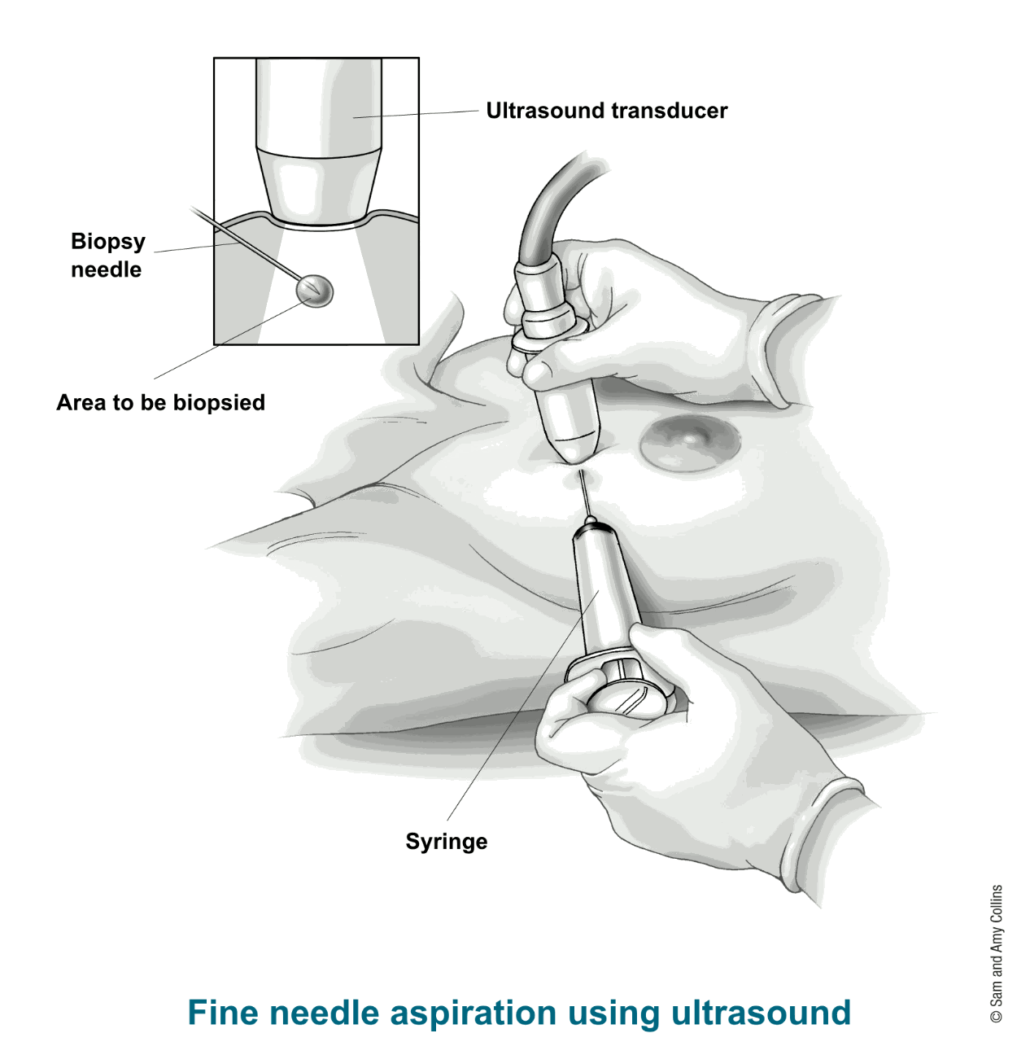
The Data
Biopsy Tissue and Measurements were obtained using Fine Needle Aspiration
Measured Properties:
Radius, Perimeter, Area
Texture
Concave Points, Concavity
Compactness((Perimeter)²/(Area-1.0))
Smoothness
Fractal Dimension
Symmetry
Source: https://www.cancer.org/cancer/breast-cancer/screening-tests-and-early-detection/breast-biopsy/fine-needle-aspiration-biopsy-of-the-breast.html
Notes:
Texture(Standard Deviation of Gray-Scaled Values)
Concave Points: Number of concave points on contour, how severe they are
Smoothness(Variation in Radius Lengths)

Slide 4
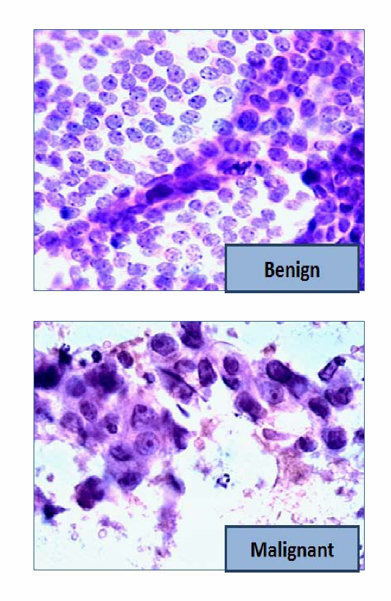
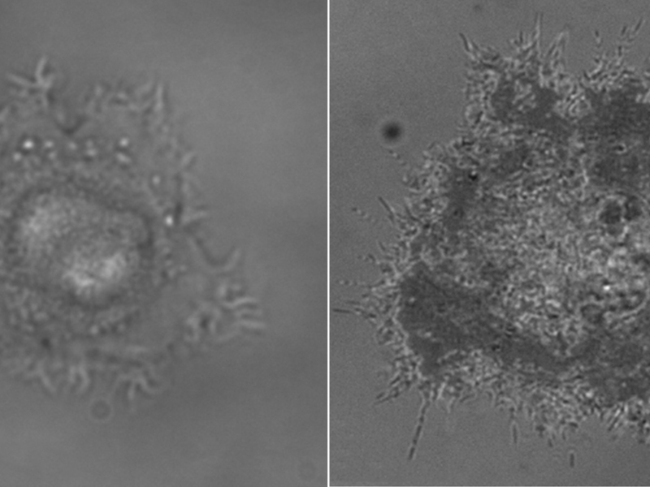
Healthy Cell
Malignant Tumor
https://medicalxpress.com/news/2013-12-malignant-healthy-cells-characteristic-fractal.html
Source: https://www.semanticscholar.org/paper/Classifying-breast-cancer-types-based-on-fine-data-Ahmad-Yusoff/60e88562a14a03e7c9be580f965180f4c9b83d08
Notes:
Mention: Analysis was done with ipython notebook with scikit learn machine learning, and seaborn visualization

Slide 5
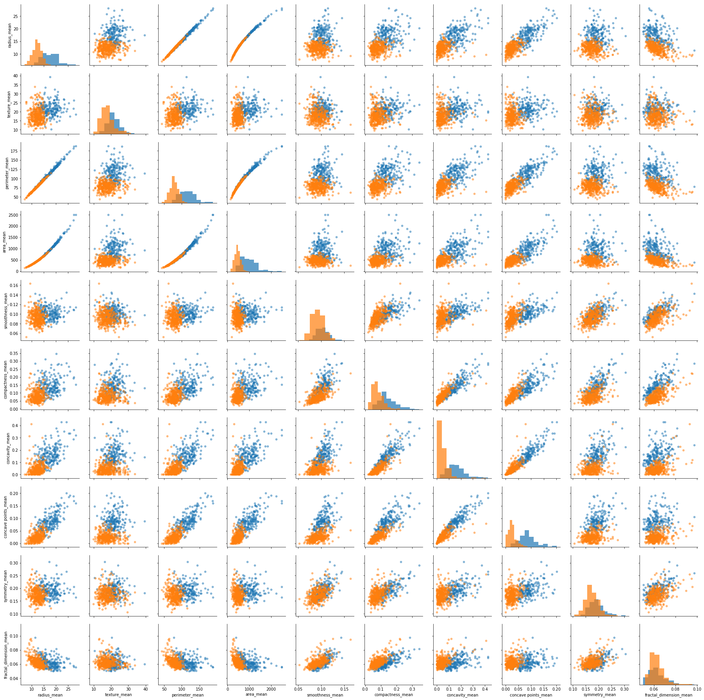
Exploratory Data Analysis: Pair Plot of all Mean Values

Slide 6
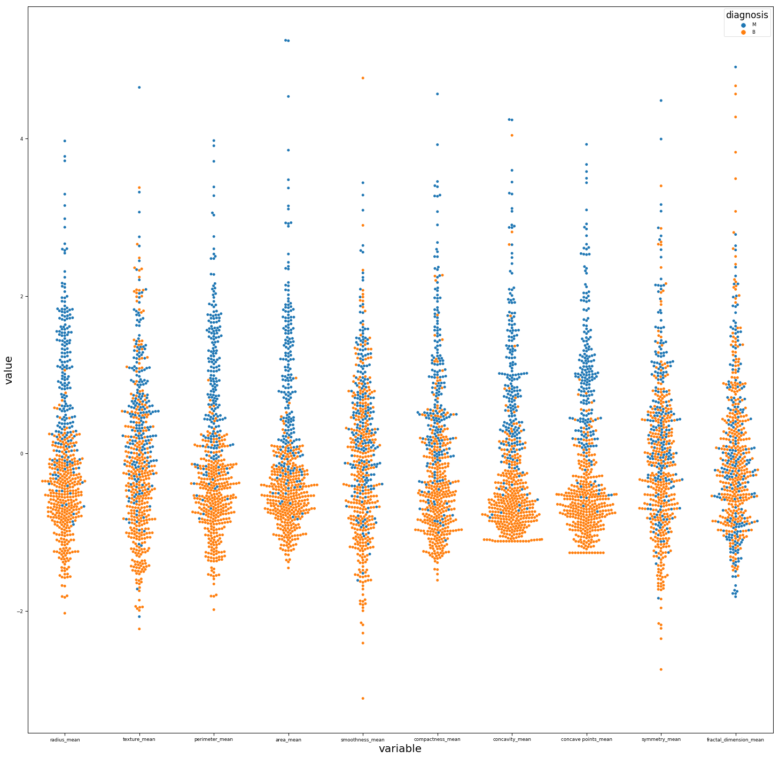
Exploratory Data Analysis: Swarm Plot of all Mean Values

Slide 7
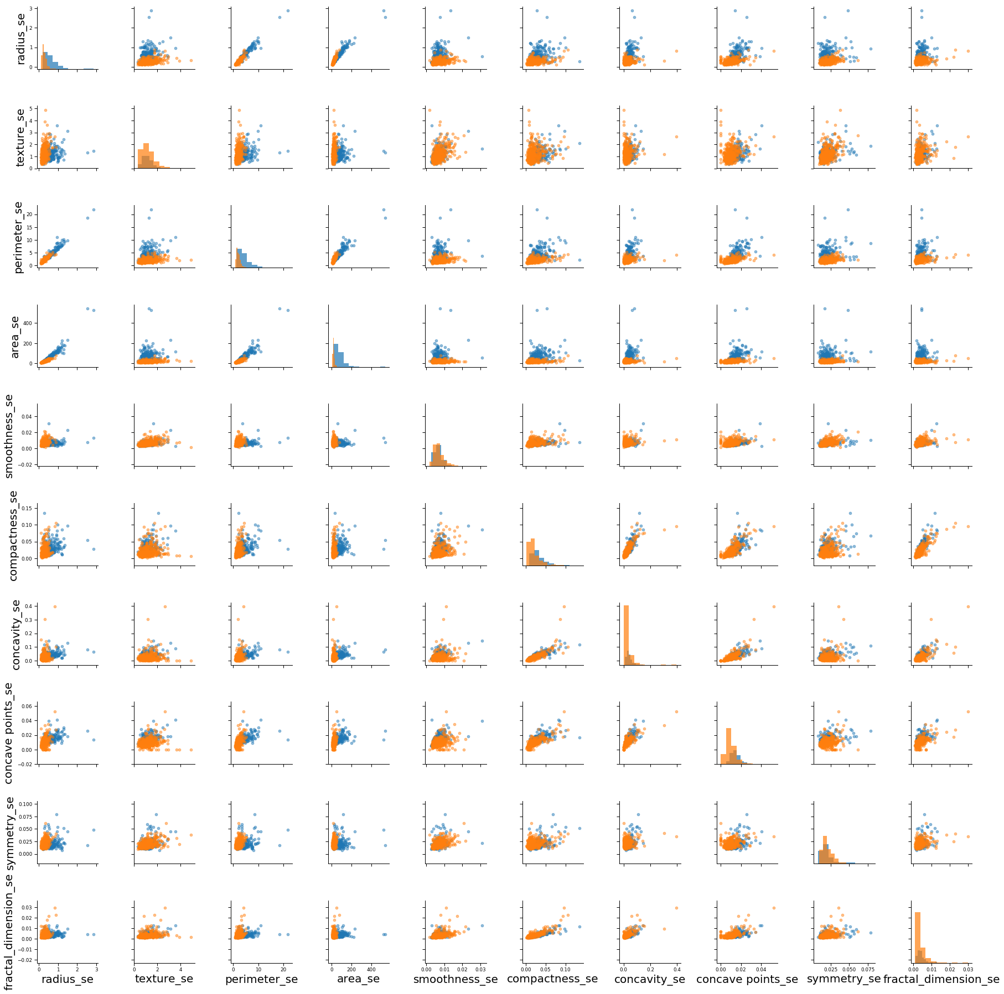
Exploratory Data Analysis: Pair Plot of all Standard Error Values

Slide 8
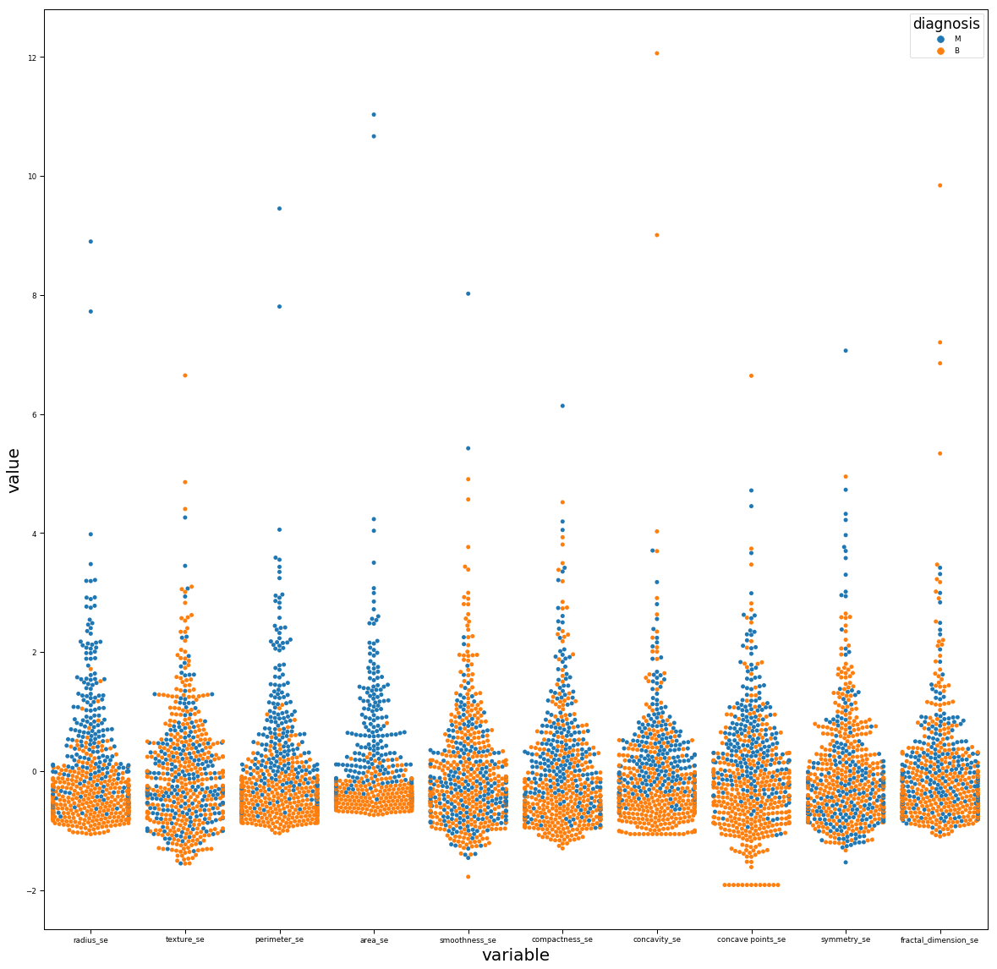
Exploratory Data Analysis: Swarm Plot of all Standard Error Values

Slide 9
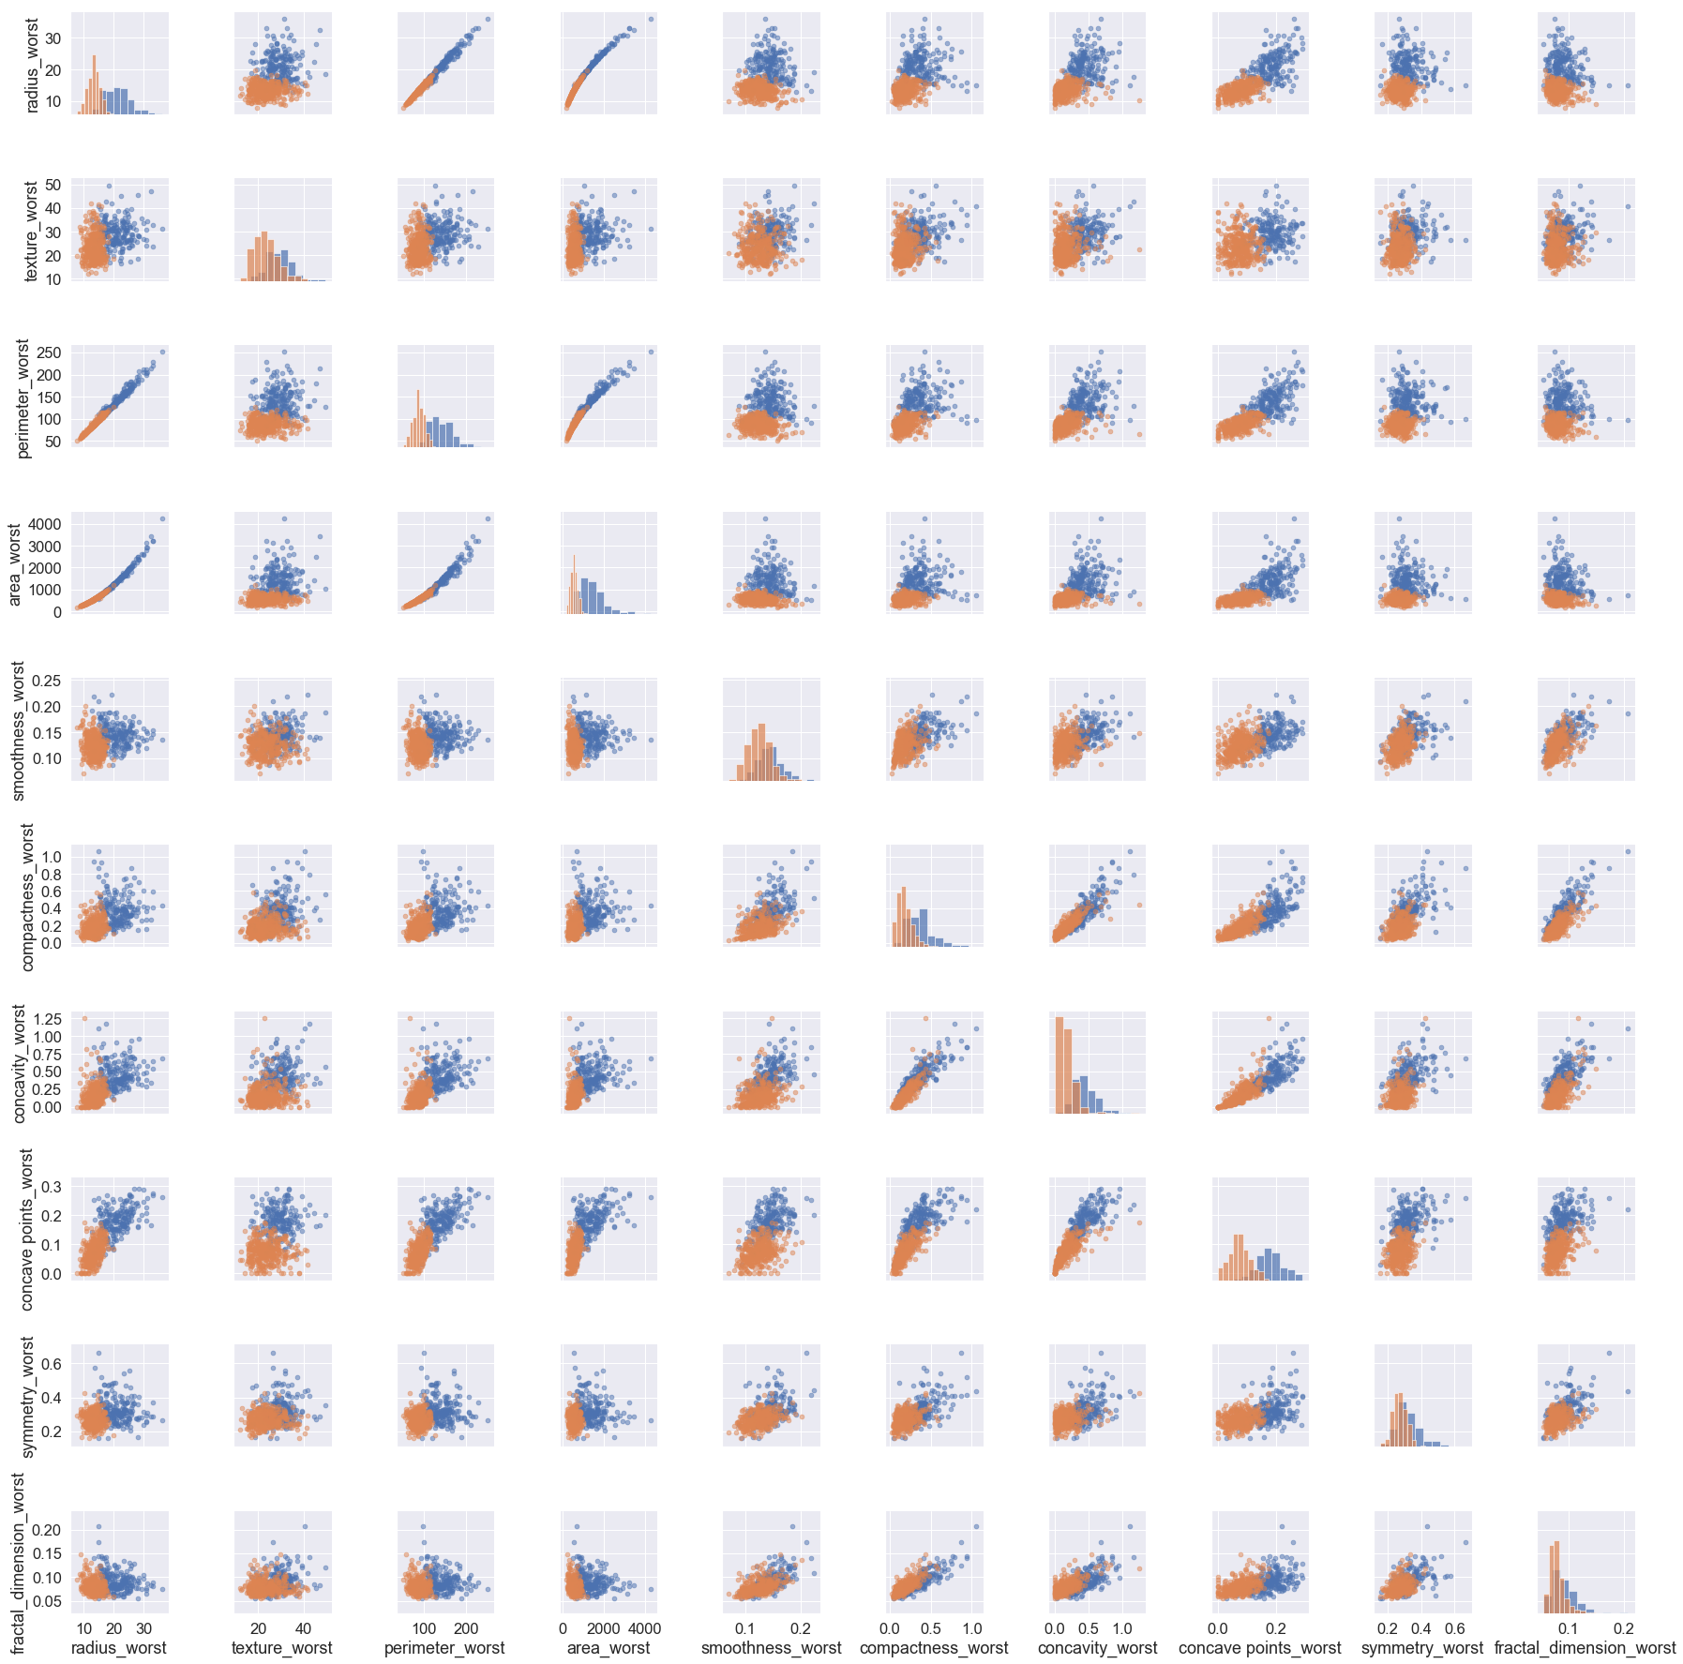
Exploratory Data Analysis: Pair Plot of all Worst Error Values

Slide 10
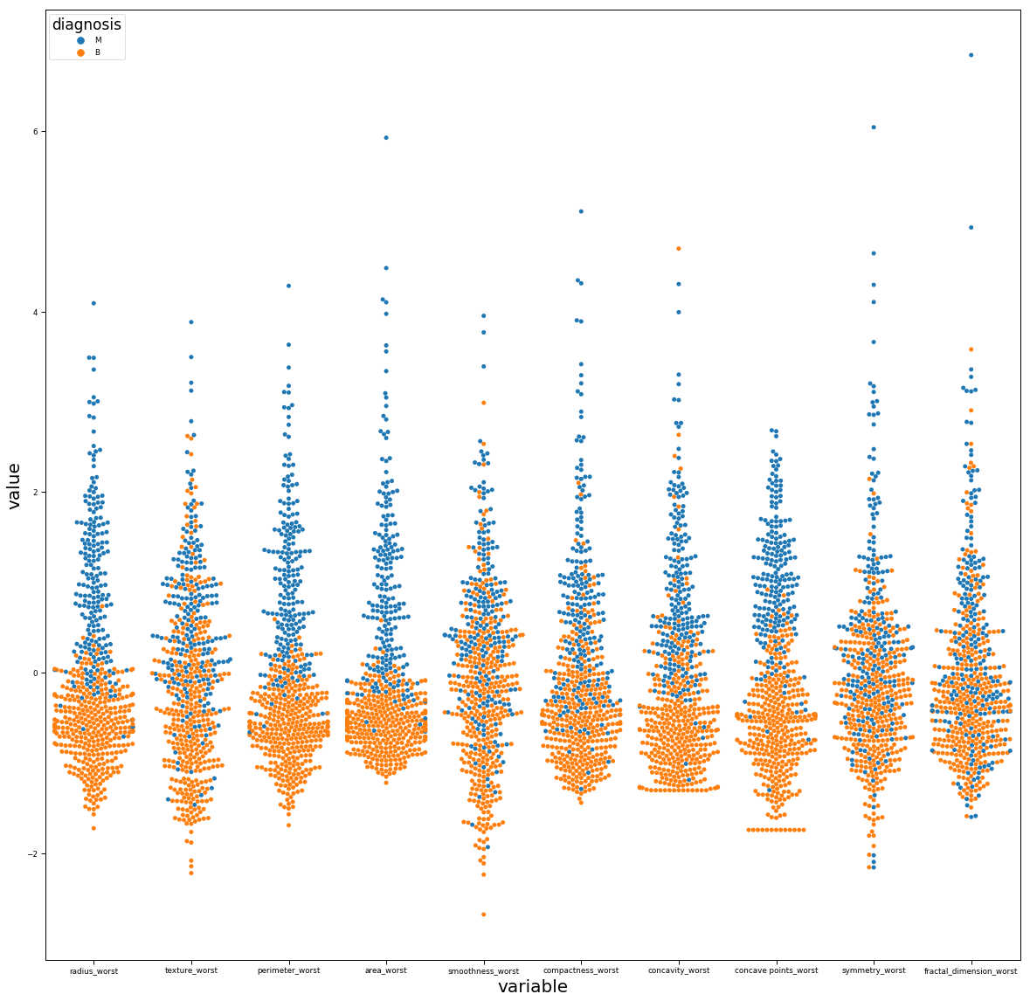
Exploratory Data Analysis: Swarm Plot of Worst Values

Slide 11
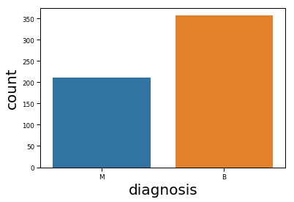
Exploratory Data Analysis: Count of Malignant and Benign Breast Cancer Tumors

Slide 12
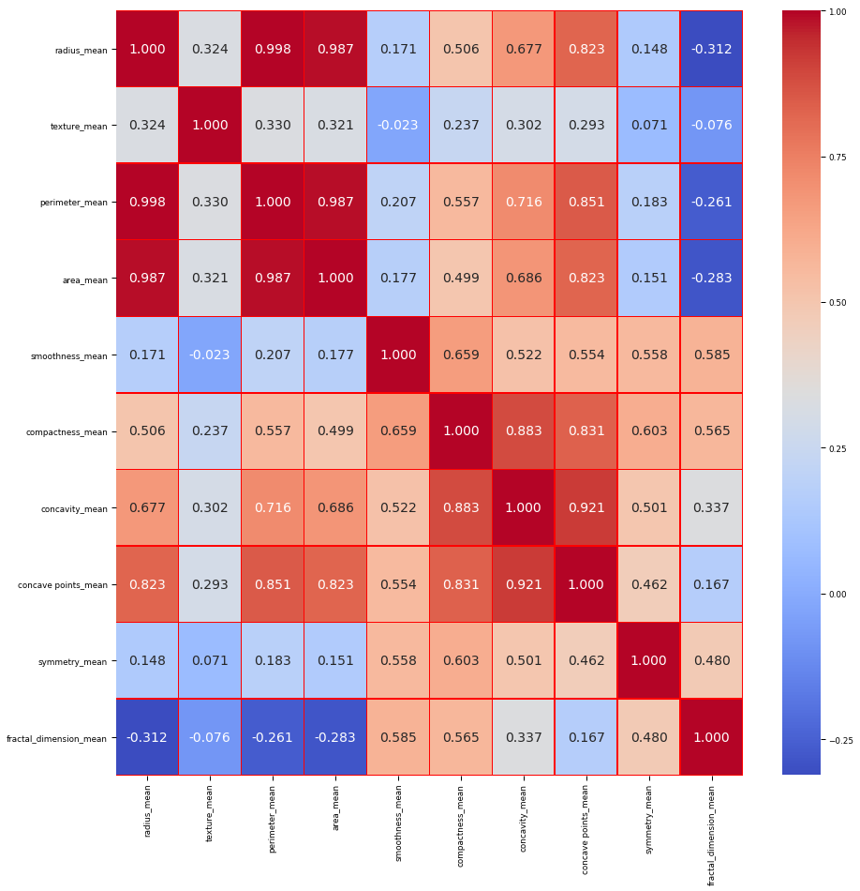
Exploratory Data Analysis: Heat Map of all Mean Values
Notes:
Area, perimeter are obviously related to radius, but which one will work better in the final model?

Slide 13
Random Forest: Test-Train Method
Split data into test-train datasets, test size 30% of complete data set
Remove perimeter and area, try them separately
Optimize random tree by setting random state to 1, and then finding best tree depth using iteration

Slide 14
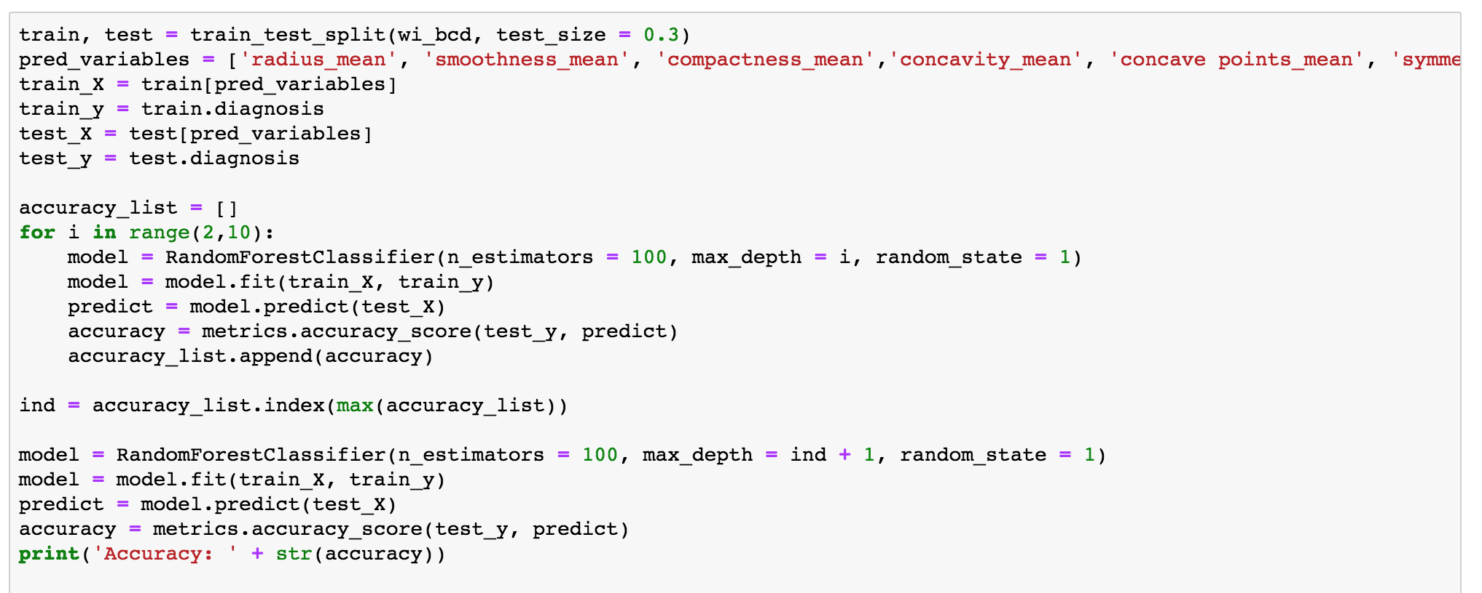

Slide 15
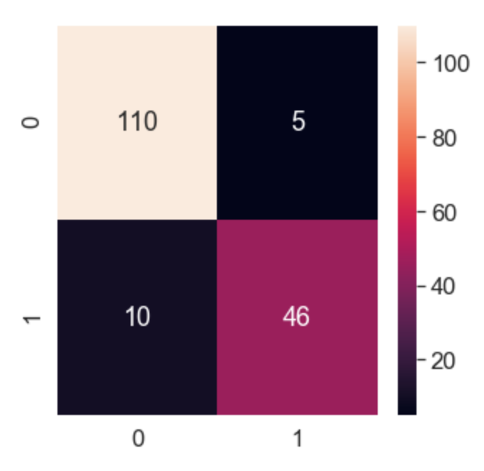
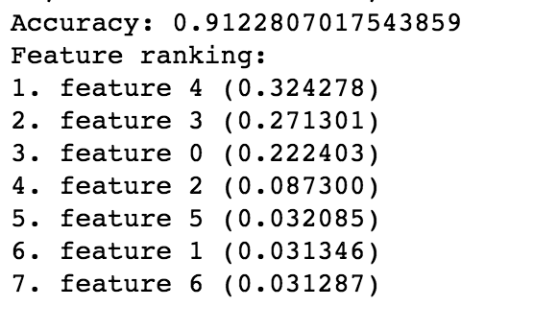
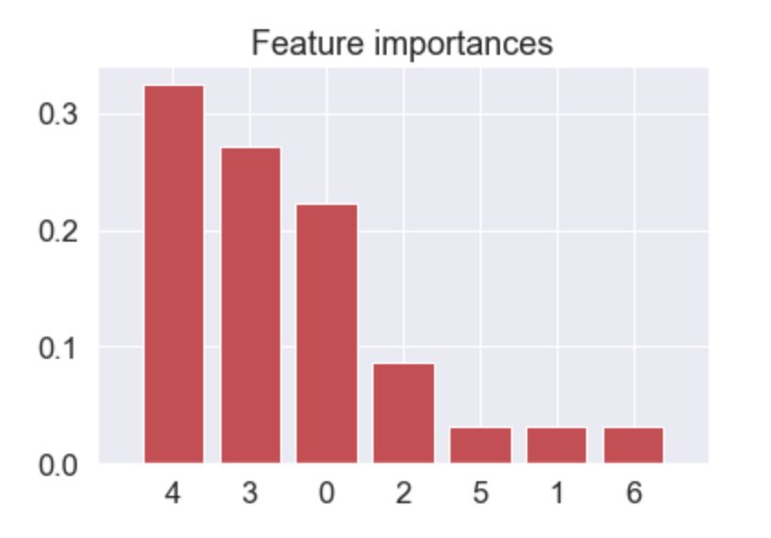
Random Forest: Test-Train
Fairly Decent Accuracy
0 = Benign
1 = Malignant

Slide 16
Summary of Random Forest
Alternating between area, radius, and mean led to essentially the same result
Test-Train Accuracy: 91%
Best Features include Concavity, Compactness, Radius and then Smoothness
Symmetry, Fractal Dimension, and Texture did not much use in the model

Slide 18
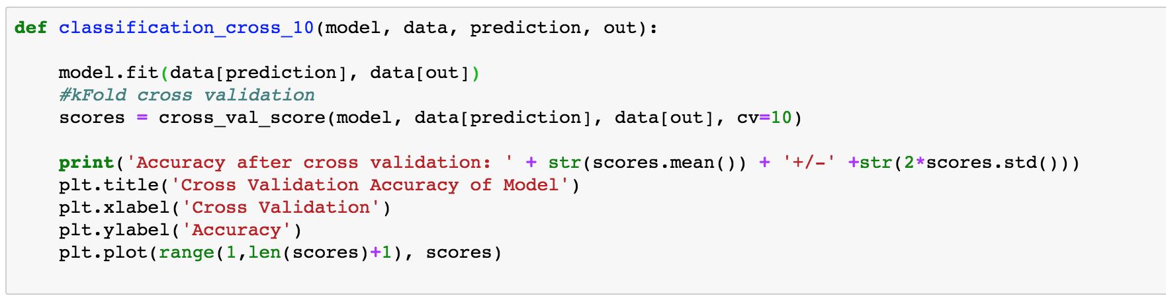
Random Forest: Cross Validation with Test-Train
Use 10-Fold Cross Validation on Entire Set, and get the Cross Validation Score and performance after each Cross Validation

Slide 19
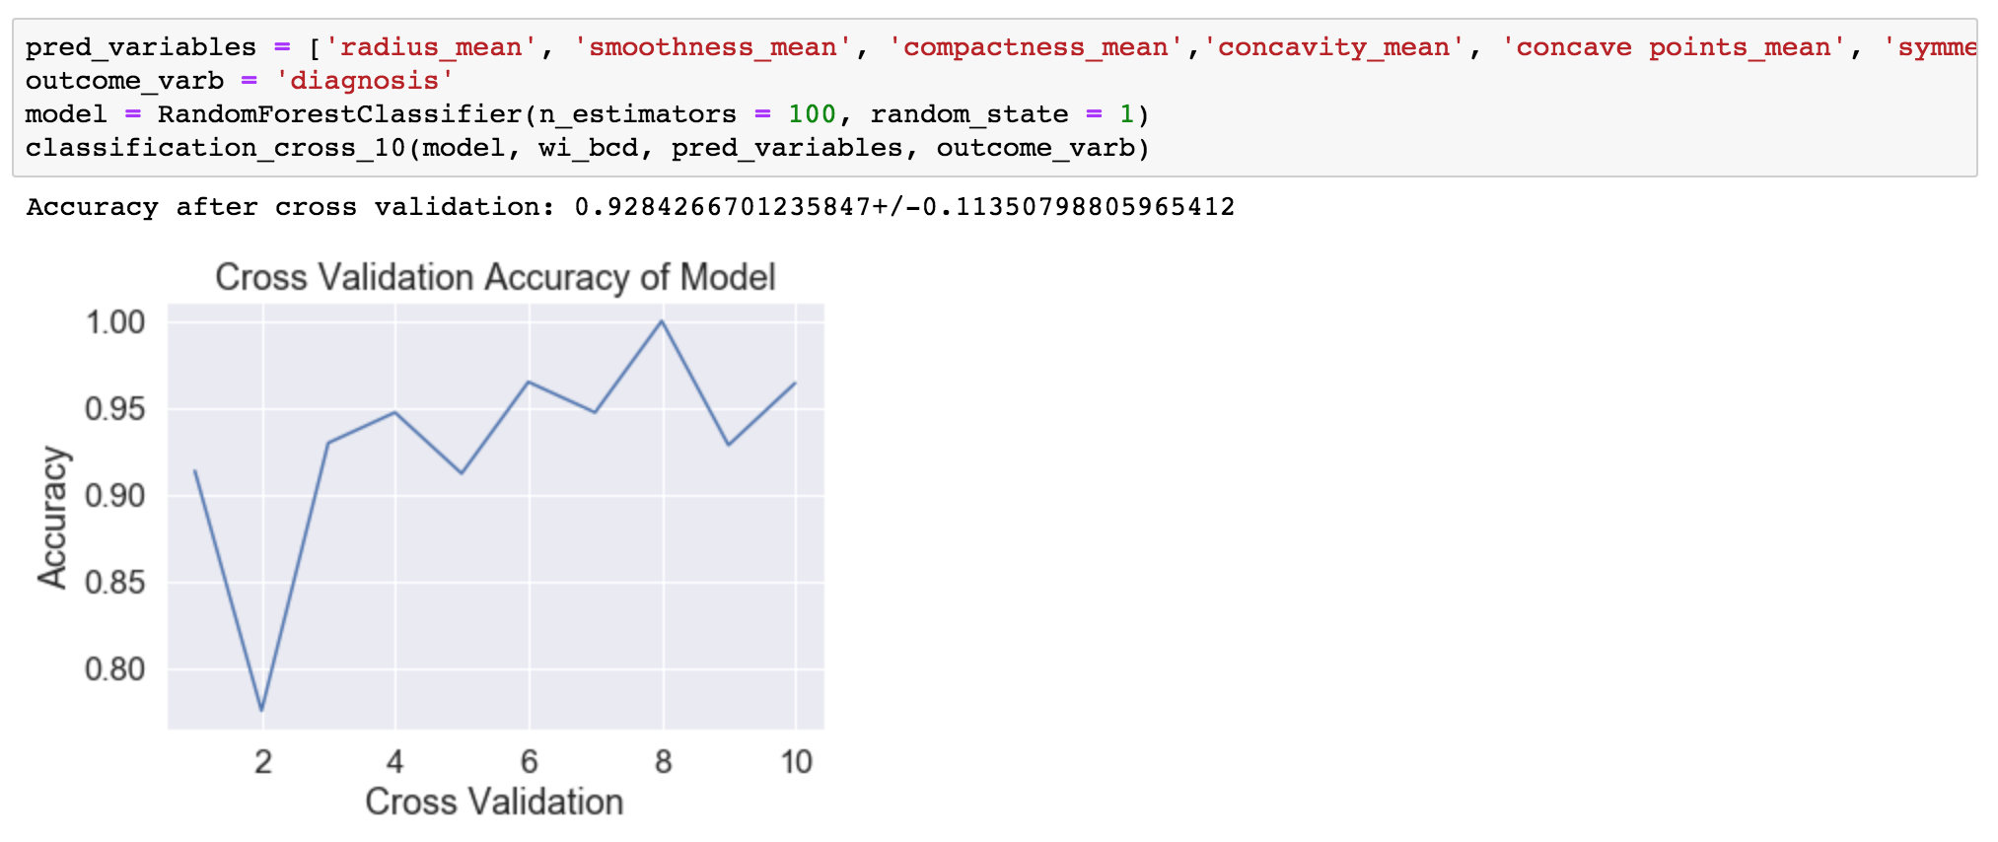
Random Forest: Cross Validation
Notes:
Using the entire data set as the training set can lead to instances of overfitting in some cases.
0.9284 ± 0.11 cross validation accuracy

Slide 20
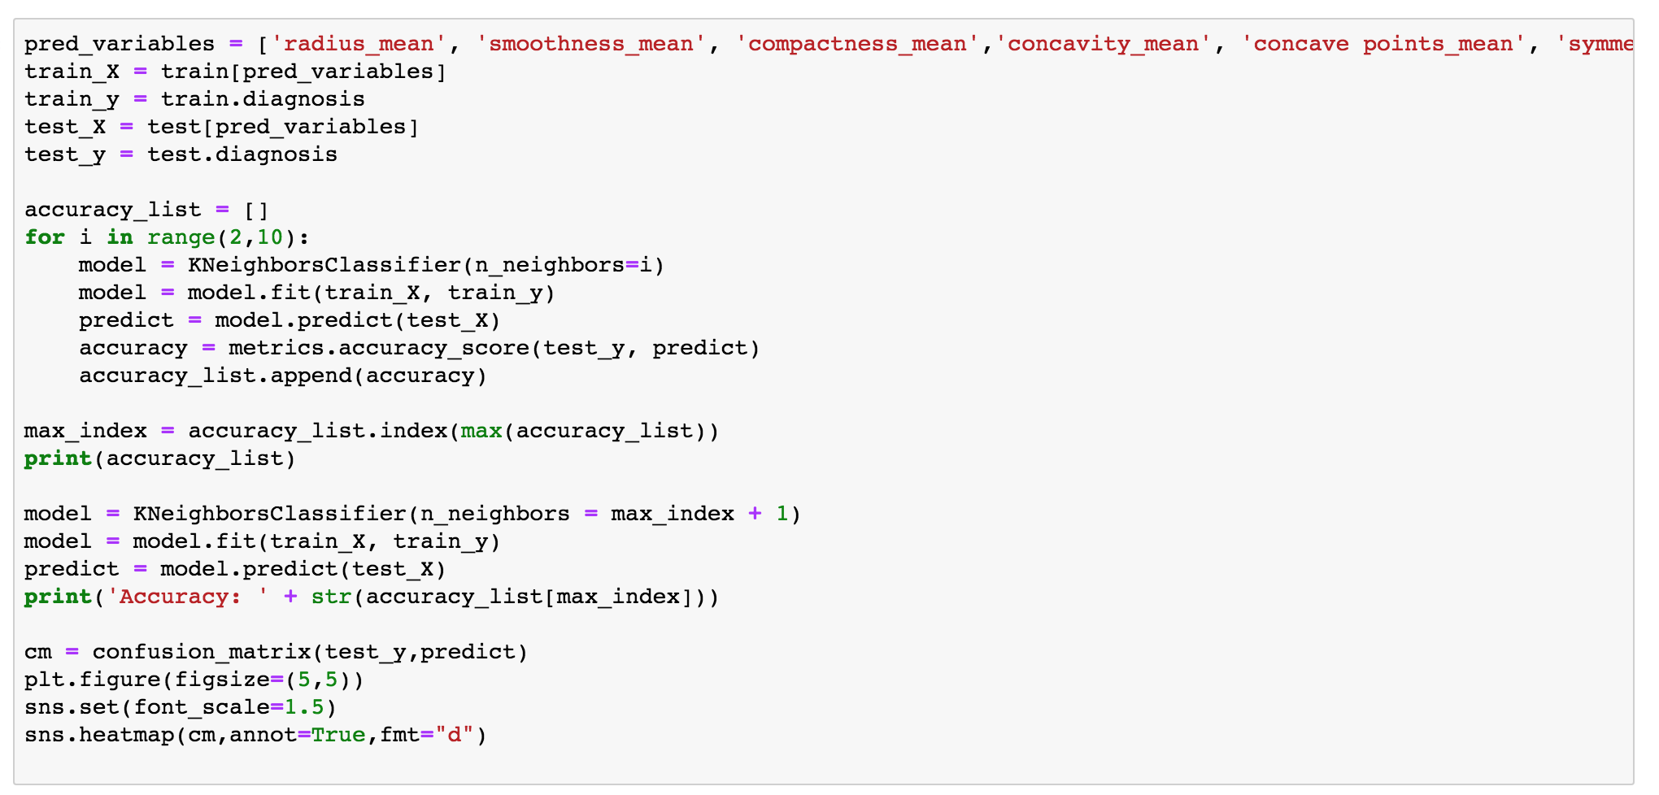
Other Models Tested
KNN Model: Produced Similar Results as Random Forest with test-train set: 0.91812 with 2 nearest neighbors

Slide 21
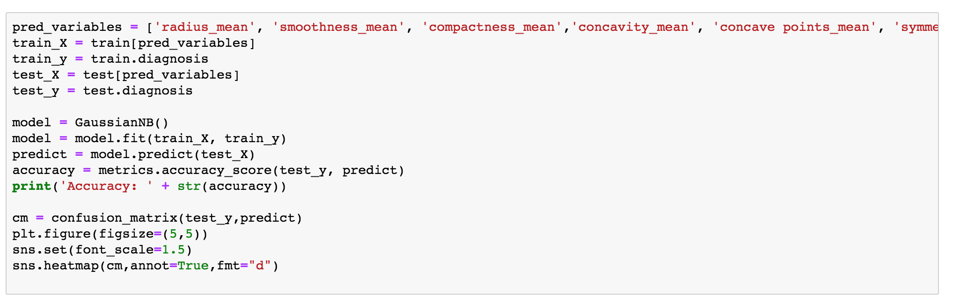
Other Models Tested
Naïve Bayesian Model: Slight Drop in Accuracy compared to other two models: 0.8888

Slide 22
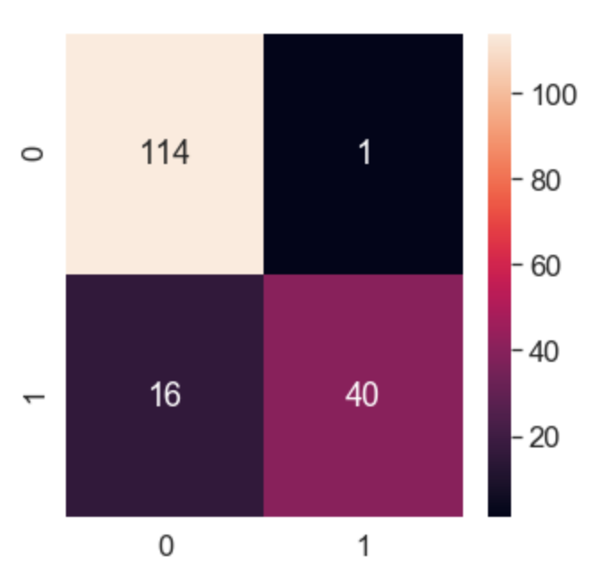
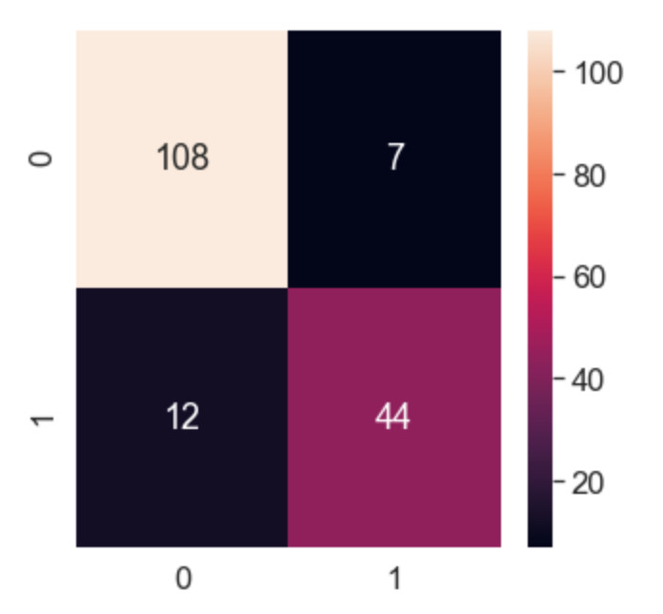
Confusion Matrix for Other Models
K(2)-Nearest Neighbors
Naïve-Bayesian

Slide 23
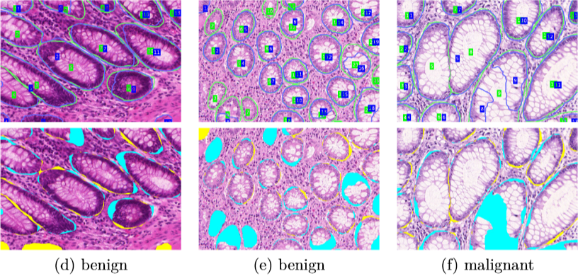
Future Directions
Implementing an Artificial Neural Network in Image Detection of Breast Cancer Tumors rather than utilizing pure numerical data
Source: https://news.developer.nvidia.com/using-cuda-and-machine-learning-to-detect-colon-cancer/

Slide 24

Special Thanks
Dr. William Yu, UCLA Anderson School
UCLA Extension
Source: uclaextension.edu

